Slide 1
MEAC 2017: Developing and Understanding Your Strengths
Lori RodefeLD, Monroe Clinic
Michelle Grosch, UW Department of Anesthesiology
Notes:
Introductions for Lori & Michelle. Each share top strengths.:
Lori’s top five – Strategic, Achiever, Input, Ideation, Activator

Slide 2
Why are we focusing on strengths?
We believe that everyone has something to contribute!
Rath & Conchie point out in Strengths Based Leadership: “whether you are taking charge in a boardroom, on a construction site, or even in your home, it is likely that you will find yourself leading at some point in your life.” (p.1)
Drucker (1999) challenged people to consider: “what should my contribution be? Given my strengths, my ways of performing, and my values, how can I make the greatest contribution to what needs to be done?” (p.25).
StrengthsFinder has proven success.
It is used in academic, business, and nonprofit settings; over 2 million people have taken it; it is available in over 24 languages
Notes:
Overview of the session – will include a variety of activities, interactive
The validity and reliability of the assessment meet very high standards.

Slide 3
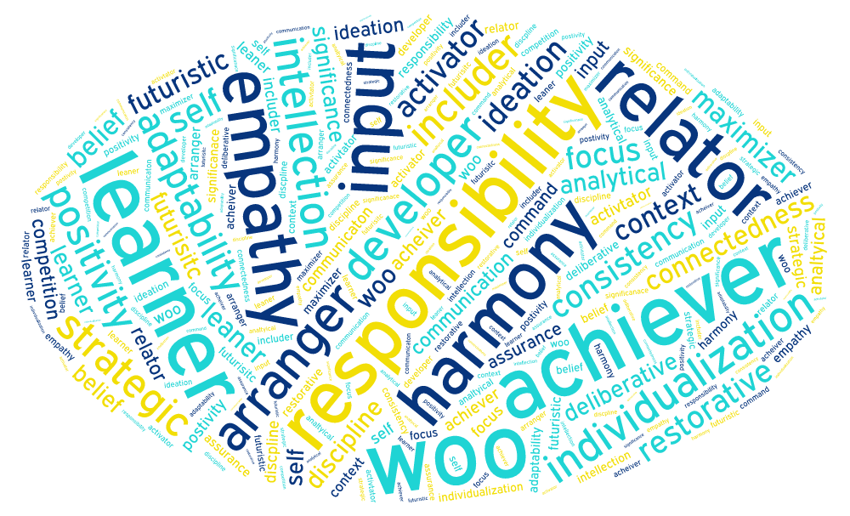
Notes:
Check in with group – able to complete assessment, bring in results?

Slide 4
Discuss a Strength
Notes:
Split up into groups of 4 – each group member will discuss their top strength OR strength that resonates most. As a group they will discuss how they view their Top Five collectively and how they see the specific strength they chose arise in their professional and personal lives. 20 minute discussion. Report out on interesting strengths/examples for 5-10 minutes.

Slide 5
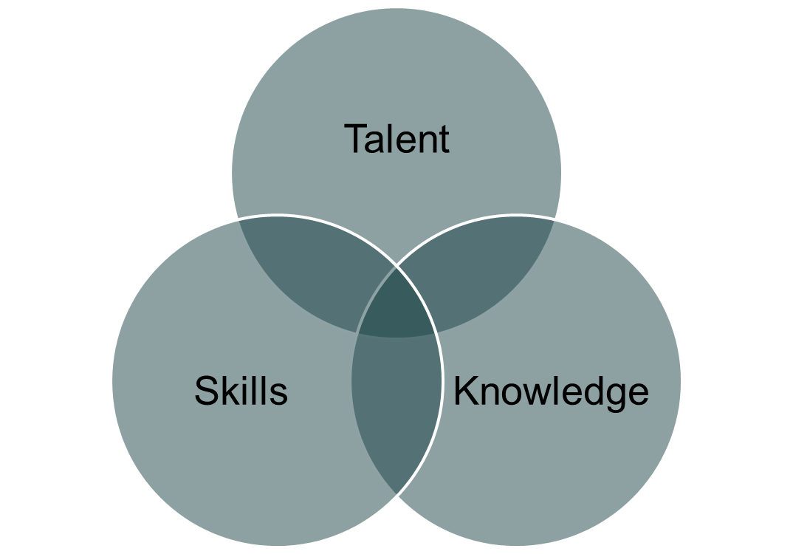
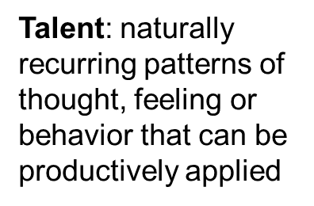
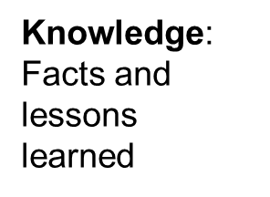
Defining a Strength
Strengths: Intersection of all three
Skills: Steps to an activity
Notes:
Background of strengths –
Strengths has origins in the 1950’s when researchers in NE were studying a rapid reading program to improve student outcomes. Data showed greatest gains in students who were already fast readers.
Example of how strengths work –
Knowledge: A teacher, who understands the issues of his students, and how they relate to his ideas.
Skill: A teacher, who has practiced articulating his ideas, so others understand them.
Talent: A teacher, who has exciting ideas that captivate students.
Reflection on strengths own report and strengths – did you find the themes accurate? Any surprises?
Typically strengths are apparent from an early age. You may have gotten in trouble for some of your strengths as a child. (i.e. example – being argumentative/strategic)

Slide 6
Identifying Your Strengths
Areas where you are innately wired to have the greatest potential
Personal development plan to help you focus on strengths
Underlying Assumptions
Talents are enduring and unique
Greatest room for growth is in the area of greatest strength
Notes:
Fun facts – top strength (both men and women) is achiever, strength least likely to appear in your top 5 is discipline
No two individuals have the same Top Five in the same order.
Why does Gallup only give you the “Top Five?”
How many people tend to ruminate on the negatives instead of the positives? That’s why. It is a natural instinct to focus on the “negatives” or “constructive feedback” or things we need to work on. However, research shows (and the HBR article explained) that individuals make much more significant gains when they focus on their natural skills and talents – the things that are positive, right, and good.
This is not to say that we should stop striving to improve or learn. It just means that it will take way more resources (time, energy, financial) to make the same amount of gain in a improvement area than it would to make the same gain in a naturally strong area.

Slide 7
Uniqueness
All 5 in a different order: 1 in 278,256
All 5 in the same order: 1 in 33,000,000
Activity “At My Best” Worksheet
Notes:
-Participants will individually complete the “At My Best” Worksheet. Allow 10-15 minutes for completion. Group discussion to follow.

Slide 8
We all lead in very different ways based on our talents and our limitations. Serious problems can occur when we think we need to be exactly like [any other] leaders.

Slide 9
Understanding the Link to Leadership and Teams
If you want to lead, it is critical to know what the people around you need and expect from you. You are only a leader if others follow.

Slide 10
Three Key Findings in Strengths Research
The most effective leaders are always investing in strengths.
The most effective leaders surround themselves with the right people and then maximize their team.
The most effective leaders understand their followers’ needs.
Notes:
The path to great leadership starts with a deep understanding of the strengths you bring to the table.

Slide 11
Consider someone you view as a leader and someone you would “follow.”
Why would you follow that person?
Notes:
-In small groups of 4 discuss the reasons why you would follow a leader. What are the most important traits or characteristics?
-5 to 10 minutes for group discussion

Slide 12
Follower’s Four Basic Needs
Trust (honesty, integrity, & respect)
Compassion (caring, friendship, happiness, & love)
Stability (security, strength, support, & peace)
Hope (direction, faith, & guidance)
Notes:
Followers have a very clear picture of what they want and need from the most influential leaders in their lives – see above list.
Relationships flat-out trump competence in building trust.
Nothing creates stability as quickly as transparency.
Leaders who are always reacting convey to the organization that they aren’t in charge or control but are being tossed about by demands of the day. When leaders instead choose to initiate, the very act can create hope for the future.

Slide 13
The (Very Different)Strengths of Leaders
Wendy Kopp Founder and CEO Teach for America | Brad Anderson CEO Best Buy | Simon Cooper President The Ritz Carlton | Mervyn Davies Chairman Standard Chartered
Achiever Competition Responsibility Relator Strategic | Context Ideation Input Learner Connectedness | Maximizer Woo Arranger Activator Significance | Achiever Futuristic Positivity Relator Learner

Slide 14
Vision Board Exercise
Reflecting on your StrengthsFinder Report, discuss the following with a partner:
Understanding my strengths how can I contribute to my department/program in the upcoming year?
What activities nurture my strengths at work and in my personal life?
Recall an accomplishment and the factors that contributed to the success. How can you nurture your strengths in a similar way to be more effective in the future?
Create a vision board that highlights your strengths and reflections
Notes:
Partner activity – pair up with one other person to discuss the above questions. 30-40 minutes allocated for creation of vision boards. Individuals will be encouraged to share after activity.

Slide 15
Strengths Based Teams
Staff participating in strengths based development programs widely report an increased understanding and respect for their co-workers, and that they work together better as a result of knowing, accepting, and working to develop the strengths that their peers bring to the table

Slide 16
4 Domains of Strengths Based Teams
Executing | Influencing | Relationship-Building | Strategic-Thinking
Achiever | Activator | Adaptability | Analytical
Arranger | Command | Developer | Context
Belief | Communication | Connectedness | Futuristic
Consistency | Competition | Empathy | Ideation
Deliberative | Maximizer | Harmony | Input
Discipline | Self-Assurance | Includer | Intellection
Focus | Significance | Individualization | Learner
Responsibility | Woo | Positivity | Strategic
Restorative |  | Relator
Notes:
Executing – knows how to make things happen
Influencing – helps teams build broader audience
Relationship building – has essential glue that holds the team together
Strategic thinker – helps team see what could be

Slide 17
The Four Domains of Strengths Based Teams
Executing
Influencing
Strategic Thinking
Relationship Building
Know how to make things happen; ability to “catch” an idea and make it a reality
Reach a broader audience; sell the team’s ideas inside and outside the organization
Glue that holds the team together; create groups and organizations that are much greater than the sum of their parts
Focused on what could be; absorb and analyze information to make better decisions
Notes:
Serves a team well to have representation of strengths in each of these four domains. Although individuals need NOT be well-rounded, TEAMS SHOULD BE!
Gallup has yet to find two leaders who have the exact same sequence of strengths … out of the 2 million people who have taken StrengthsFinder!

Slide 19
Opportunities for Teams
Complimentary Partnerships - some examples:
To “make up” for a lesser talent
To “take over” where one person leaves off
To “enhance” what one person already possesses
Creating a Team Grid:
Understanding the theme dynamics of your team helps you to be a more successful and productive team.
Acknowledge team's strengths.
Consider assignments/roles based on strengths.

Slide 20
Next Steps….
Remember to remember your strengths – make them visible!
Discuss your strengths
Turn your volume up or down
Get clear on your needs – reflection activity
Notes:
-Make them visible: display your vision board, put them on a reminder card in your office
-Discuss strengths with others: share with your team, arrange for the team to take the assessment, tell your boss/manager about your strengths
-Turn volume up/down: look at how you are feeling. If you’re burnt out you may have your strengths in overdrive. If you’re feeling unheard or frustrated find a way to turn the volume up and play to your strengths. If you feel engergized/satisfied the volume is at an optimal level.
-Needs reflection: think of the last frustrating experience you had. Break it into smaller pieces, were any of your strengths not used, not appreciated, violated? Often frustrations are liked to strengths.

Slide 21
Questions?

Slide 22
References
Buckingham, M. (2007). Go put your strengths to work. New York: Free Press.
Buckingham, M. (2006). Trombone player wanted [DVD]. Beverly Hills, CA: The Marcus Buckingham Company.
Buckingham, M. & Clifton, D.O. (2001). Now, discover your strengths. New York: Free Press.
Maxwell, J. (1999). 21 indispensable qualities of a leader. Nashville, TN: Thomas Nelson Publishing.
Rath, T. & Conchie, B. (2008). Strengths based leadership: Great leaders, teams, and why people follow. New York: Gallup Press.

