Slide 1
Remediation: Tips for Effective Documentation
Angie Womble, Education Coordinator
University of Wisconsin Department of Family Medicine and Community Health
Baraboo Rural Training Track Residency

Slide 2
Goals
Discover WHY documentation in remediation is so important
Learn HOW to document
Learn WHAT to document
Learn WHO needs to document
Learn WHEN to document
Notes:
About me: I’ve been in GME for 6 years, started as an assistant coordinator which evolved into the coordinator role about one year later. My program consists of 6 FM residents, a 2-2-2 program. Prior to my GME gig, I dwelled in the Human Resources world.

Slide 3
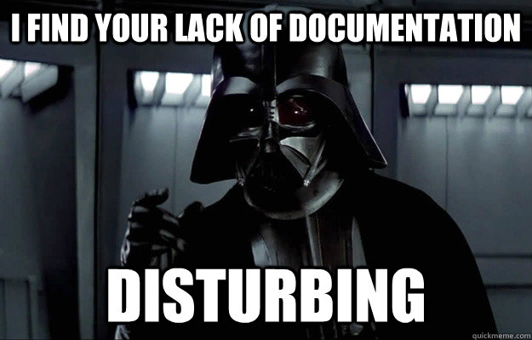
Golden rule: If it isn’t documented, it didn’t happen!
Notes:
The most common response when lodging a complaint, or negative evaluation is, “can you get that to me in writing”? Management, HR, and legal will all ask for supporting written documentation; gather your facts correctly!

Slide 4
Key Players in Remediation
Program Coordinator
Program Director (PD)
Associate Program Director (APD)
Designated Institution Official (DIO)
Human Resources (HR)
Legal
Notes:
The Program Coordinator is

Slide 5
Case study
Anita Break, PGY3 is in her final months of residency training. Throughout the course of residency, Anita has been placed on a learning plan twice, for similar issues as noted below. The deficient areas improved, and eventually behavior and absenteeism started up again. Resident also presented as fatigued.
Professionalism
Absenteeism
Dress code noncompliance
Informal language/manner with staff and patients
Communication
Presentations lack focus
Exam integrity and lack of follow-up/appropriate documentation
Medical Knowledge
Preventive Care knowledge base deficit
Notes:
One key note: The deficient areas would improve, Anita was removed from the LP, then eventually the behavior worsened, absenteeism started up again. Resident presented as fatigued.

Slide 6
Small Group Work
What would you do?
What concerns you about this resident?

Slide 7
Notes:
Small group share….

Slide 8
END RESULT
Formal Probation May of PGY3
Slight improvements noted, briefly
Violated terms of probation during final month of residency
Anita resigned from residency just days before graduation
Notes:
Due to consistent regression in the areas addressed in the learning plans, the resident was placed on formal probation in May of PGY3. Program noted slight improvement, but very briefly. Resident violated terms of probation during final month of residency, specifically in the areas of professionalism and absenteeism, and as such, resigned from the program just days before graduation. Resident was noted to have significant impairment, limiting her ability to competently practice medicine.

Slide 9
So why do we document?
Notes:
Group participation. Brainstorm.

Slide 10
WHY Document
Written notification for resident/student of deficiency
Information gathering – to provide program administration with necessary information to determine if a remediation plan is warranted and to ultimately develop the plan.
Justification for remediation and possible dismissal from program.
Protects individuals and the institution from legal action.

Slide 11
What to Document
Learner deficits
Evaluations (formal and informal)
Emails (from faculty/staff/residents, etc.)
Verbal feedback (get this in writing!!)
Summaries of any meetings held to specifically discuss learner
Learner expectations
Residency Manual
ABFM Professionalism Requirements
ACGME Requirements
Rotation Goals and Objectives
Program Requirements

Slide 12
How to Document – What to include
Identify the deficit
Provide as much detail as possible
Categorize the competency area of focus
The date the observed deficit occurred
Who identified the deficit
Was learner provided formative feedback, i.e. in the moment?
If possible, obtain written proof that the feedback was provided.

Slide 13
TIPS
Email and text date/time stamps are your friends. Hold them near and dear
Watch for patterns in behavior and performance
Consider your evaluation source
Instincts – trust them; if you believe a conversation should be documented, then document it
Confidentiality and respect are key
Stay organized – maintain a separate file
Always! Always! Always! follow due process – residents and students are protected under the 14th amendment
Be prepared
Be specific
Maintain professionalism in ALL documentation – these can and may be used in formal proceedings
Notes:
14th amendment requires the right of procedural due process

Slide 14
Tools
Books
Remediation of the Struggling Medical Learner; Jeannette Guerrasio, MD
Remediation in Medical Education; Adina Kalet, Calvin L. Chou
Understanding Medical Professionalism; Wendy Levinson, Shiphra Ginsburg, Frederic W. Hafferty, Catherine R. Lucey
Sample Probation Template (in handouts)
Sample Learning Plan Template (in handouts)
Sample documentation (in handouts)

Slide 15
Acknowledgement Special thank you to Michelle Grosch, MA.

